Slide 1
Presentation skills Presented by I Divyateja – 160122749041 Dept of CSE (IOT) Chaitanya Bharathi institute of technology

Slide 2
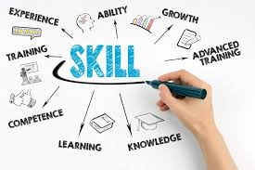
Importance of Presentation Skills
Engages the audience
effectively
Helps convey ideas clearly
Builds confidence and leadership skills

Slide 3
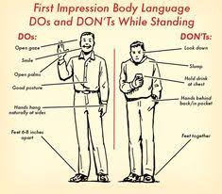
Key Aspects of Effective Presentation Skills Content Clarity Engagement Techniques Confidence & Body Language Visual Aids & Design Practice & Delivery

Slide 4
How to Improve Presentation Skills 📝 Content Clarity – Keep your message simple, structured, and easy to follow. Avoid cluttered slides and complex jargon. 🎤 Engagement Techniques – Use storytelling, ask questions, and encourage interaction to keep the audience interested. 💡 Confidence & Body Language – Maintain eye contact, stand tall, and use hand gestures to reinforce key points.

Slide 5
Dos & Don’ts of Presentation Skills
✅ Dos:
Maintain eye contact with the audience
Use clear and concise language
Engage with visuals and examples
Practice before presenting
Use confident body language

Slide 6
❌ Don’ts:
Read directly from slides
Overload slides with text
Speak too fast or too slow
Ignore audience feedback
Use distracting gestures

Slide 7
Thank you

